Slide 1

Super Store Database
MYSQL
Project - 1
PRESENTED BY:
Jeevarathnam R T

Slide 2

In the upcoming slide You will see
The Function which are
Mentioned below:
Data Retrieval and Basic Queries
Filtering and Sorting Data
Joining Tables
Data Aggregation and Grouping
Advanced SQL Functions
Creating Views and Stored Procedures
Apply subqueries and common table expressions (CTEs)
Data Insights and Reporting
Agenda

Slide 3
Database structure
Back to Agenda
CATEGORIES
PRODUCTS
SUPPLIERS
ORDER_DETAILS
ORDERS
CUSTOMERS
SHIPPERS
EMPLOYEES

Slide 4
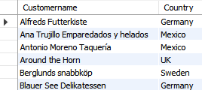
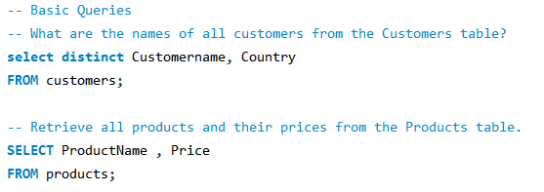
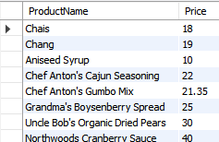

Basic Queries
Back to Agenda
Extract information from individual tables to understand the structure and contents of the database.
Retrieve lists of customers, products, categories, employees, shippers, and orders using simple SELECT queries.

Slide 5
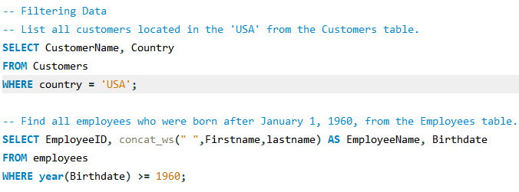
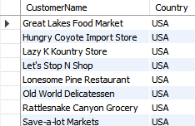
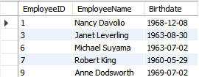
Filtering Data
Back to Agenda
Implement filtering to retrieve specific subsets of data, such as customers from a particular country or employees born after a certain date.
Sort data based on various attributes, such as product prices, order dates, or customer names.

Slide 6
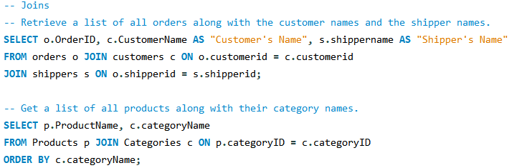
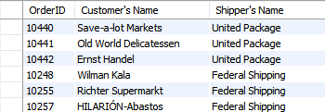
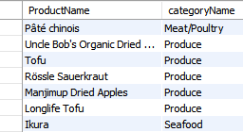
Joins
Back to Agenda
Perform inner joins, left joins, right joins, and full joins to combine data from multiple tables and retrieve comprehensive information, such as order details along with customer and employee names.
Join tables to analyze relationships between entities, such as products and their categories or orders and their shippers.

Slide 7
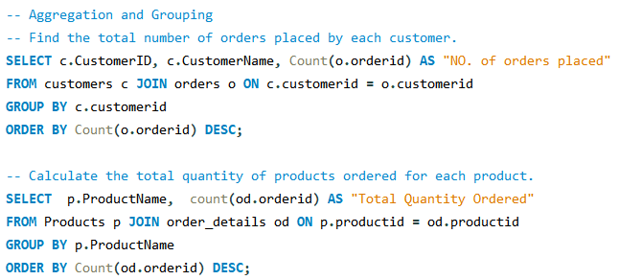
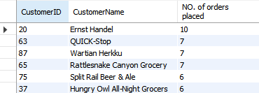
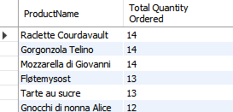
Aggregating and Grouping
Back to Agenda
Use aggregate functions like COUNT, SUM, AVG, MAX, and MIN to generate summaries of the data, such as total orders per customer or average product price per category.
Group data by specific attributes to generate meaningful reports, such as the number of orders per shipper or total sales per product category.

Slide 8
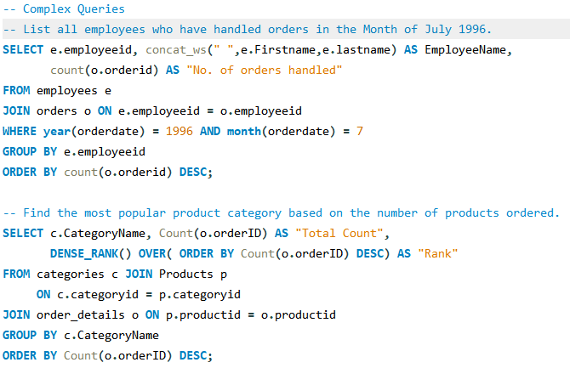
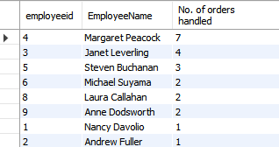
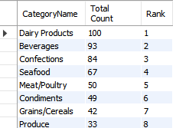
Complex queries
Back to Agenda
Here we used different function used in before slide altogether at one query
Optimize query to retrieve the most relevant data

Slide 9
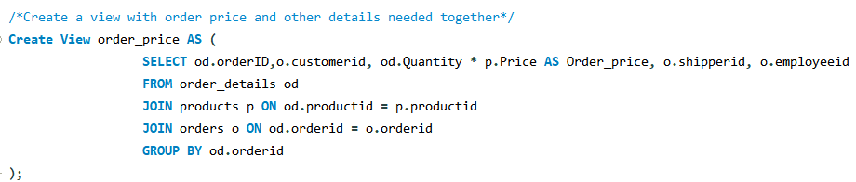
Create a VIEW
Back to Agenda
We use view to create a temporary table to retrieve data from.
CTE’s are used with the query .
View can be called from any query once created.
View can be created within single table with aggregation or combination of two or more tables .
It increases optimized timing and simplify with reusability.
Here we need total amount of order .
So we create a view with aggregated column of quantity and price for sum of price to get the order price

Slide 10
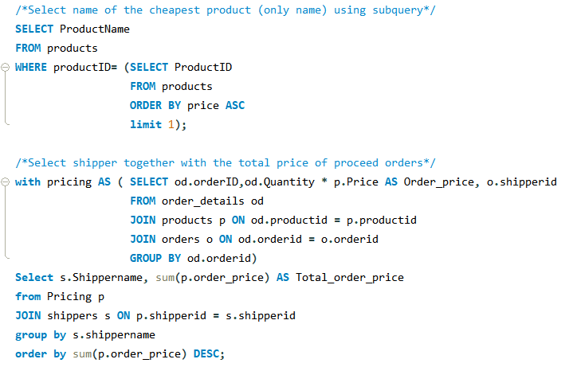
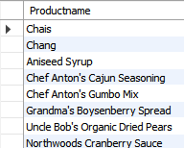

Subqueries
Back to Agenda
Use subqueries to combine and compare data across multiple tables.
Break down complex queries into simpler subqueries to improve readability and maintainability.

Slide 11
Subqueries & CTE’s
Back to Agenda
Subqueries and Common Table Expressions (CTEs) to break down complex queries and improve readability and maintainability.
Optimize query performance by reducing data retrieval complexity.
Enable dynamic and conditional data retrieval.
They simplify complex queries by breaking them into manageable parts.

Slide 12
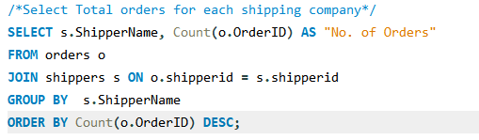

Data Insights and Reporting
Back to Agenda
United packages has handled the most no of shipments handled
The sum of total no of orders handled is 74

Slide 13
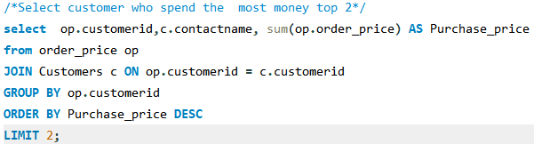

Back to Agenda
The top 2 customers who have contributed the company revenue are :
Jytte petersen
Roland mendel

Slide 14
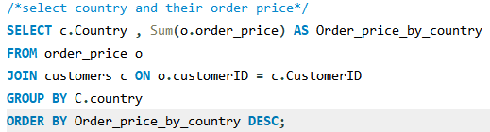


Back to Agenda
Top contries by purchase power are
USA
Germany
Austria
Denmark
Countries we need to develop on:
Argentina
Norway

Slide 15
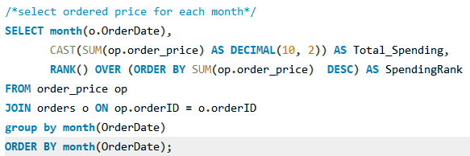
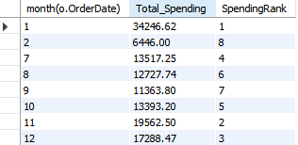
Back to Agenda
Top selling month is Jan
November and December has high sales compared to other months
we could see a Trend on last two months of the year

Slide 16
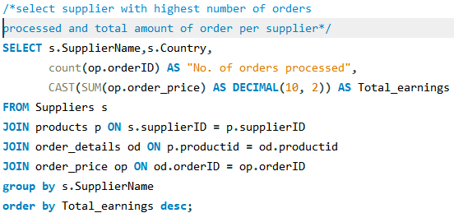

Back to Agenda
These suplpliers have contributed more to the store than other suppliers
Total earnings from these suppliers to the country can say that these suppliers have high productivity

Slide 17
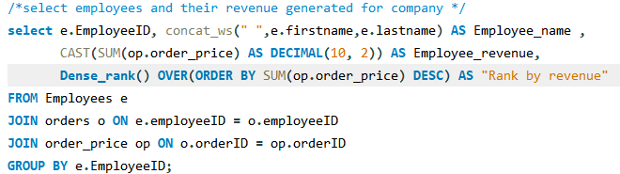
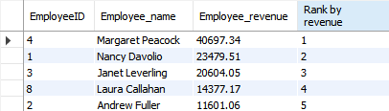
Back to Agenda
Marget peacock has made a high revenue
second person have revenue of half of marget

Slide 18


Back to Agenda
Total revenue of store is 128,545$

Slide 19

Back to Agenda
These are the examples to show how we can use MYSQL to retrieve data from Database.
Insights which retrieved shows the trends and values from data
Trends - Nov, Dec has high sells value
Values - Highest revenue employee, highest sold suppliers etc.
We can further dive into the data and retrieve most important info to help our client
We can get information's from original data to support our assumptions or prove it.

Slide 20

Recommendations
Back to Agenda
Use simple and clear queries
Avoid complexing queries and try to optimize it
Use views , CTE’s to simplify
Learn and practice SQL and experiment in it.

Slide 21

Back to Agenda
Get In Touch
Email
Jeevarathinam969@gmail.com
Social Media
@jeevarathnam R T

